Slide 1
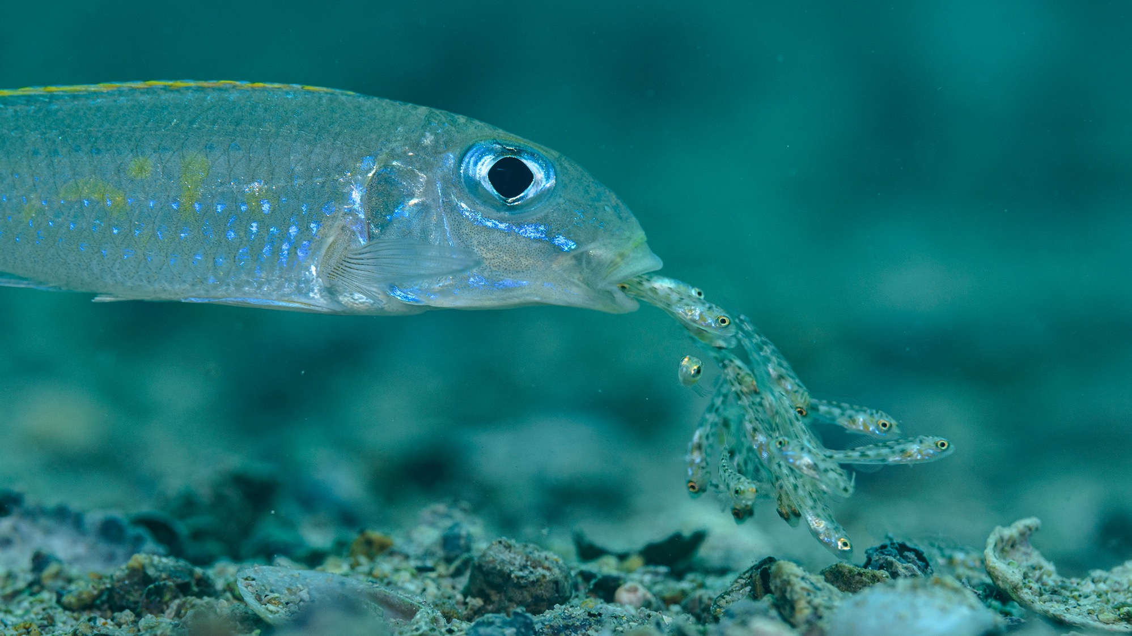
Evolution
Speciation

Slide 2
What is a species?
A species is the smallest evolutionary unit
Species form a boundary for the spread of alleles
Mutation, selection, gene flow, and drift act separately on different populations within species
Sounds simple, but in practice determining criteria for identifying when populations are actually evolving independently is not straightforward

Slide 3
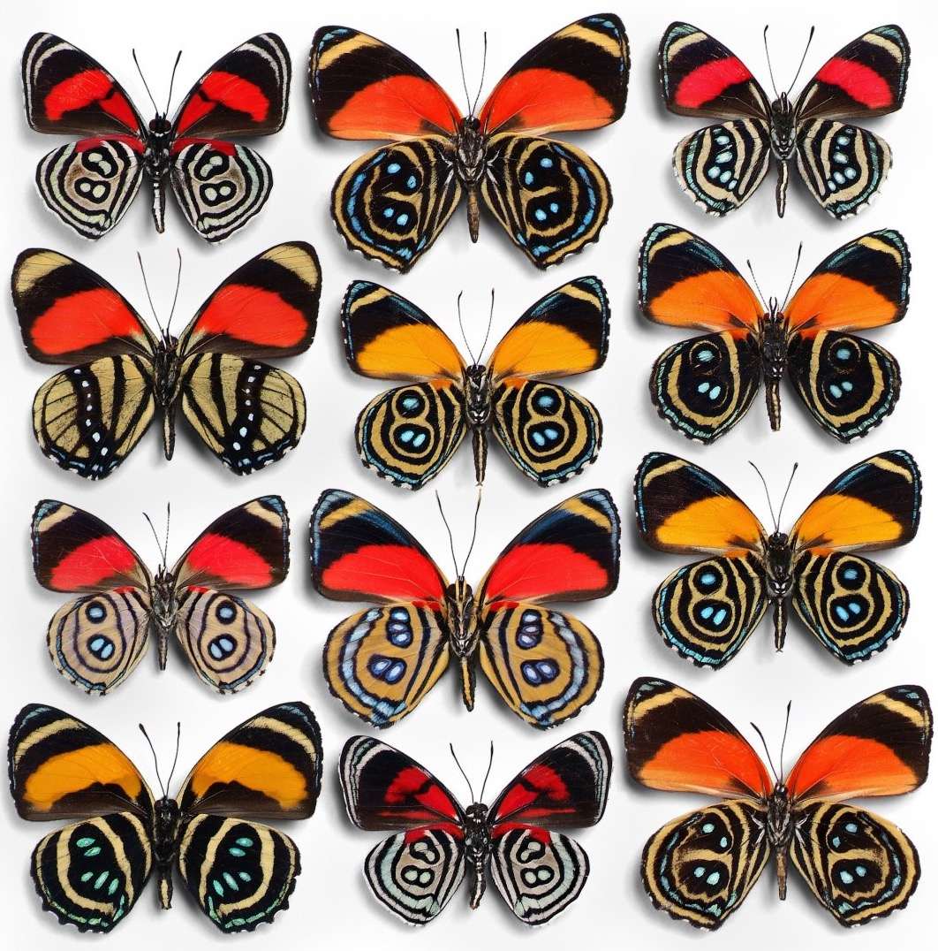
Species concepts
Typological…
Morphological…
Phylogenetic…
Evolutionary…
Genetic…
Cohesion…
Recognition…
Ecological…

Slide 4
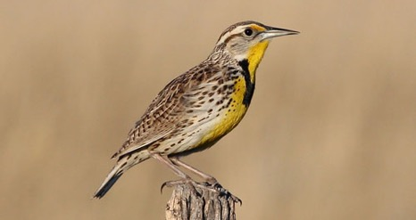
Biological species concept
This concept groups organisms based on reproductive isolation (species do not or rarely hybridize in nature)
Biologically meaningful definition, because it confirms lack of gene flow
It is the only species concept that acknowledges that species are true natural entities (objective definition), rather than just arbitrary human constructs

Slide 5
R Notebook, part 1
One species… or two? Combining insights from morphological, phylogenetic, and behavioral analyses
ggplot with geom_boxplot
Use facet_wrap(~ variable, scales = "free") to make multiple plots at once
ggtree
ggplot with geom_bar or geom_point

Slide 6
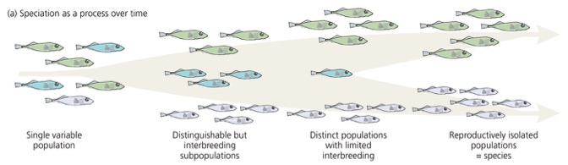
Speciation as a process
The focus on reproductive isolation allows us to infer something about the process of speciation
Variation in natural systems is distributed along a speciation continuum
Movement along the continuum can be bidirectional: speciation vs. hybridization
Common assumptions: transitions along the speciation continuum are not readily observable

Slide 7
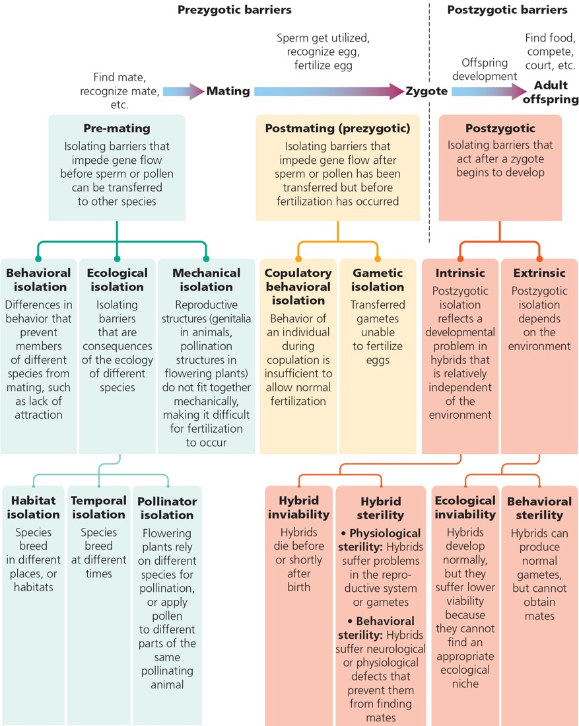
Mechanisms of reproductive isolation

Slide 8
Mechanisms of reproductive isolation
Pre-mating isolation
Ecological isolation
Habitat isolation
Temporal isolation
Pollinator isolation
Behavioral isolation
Mechanical isolation

Slide 9
Mechanisms of reproductive isolation
Pre-mating isolation
Ecological isolation
Habitat isolation
Temporal isolation
Pollinator isolation
Behavioral isolation
Mechanical isolation

Slide 10
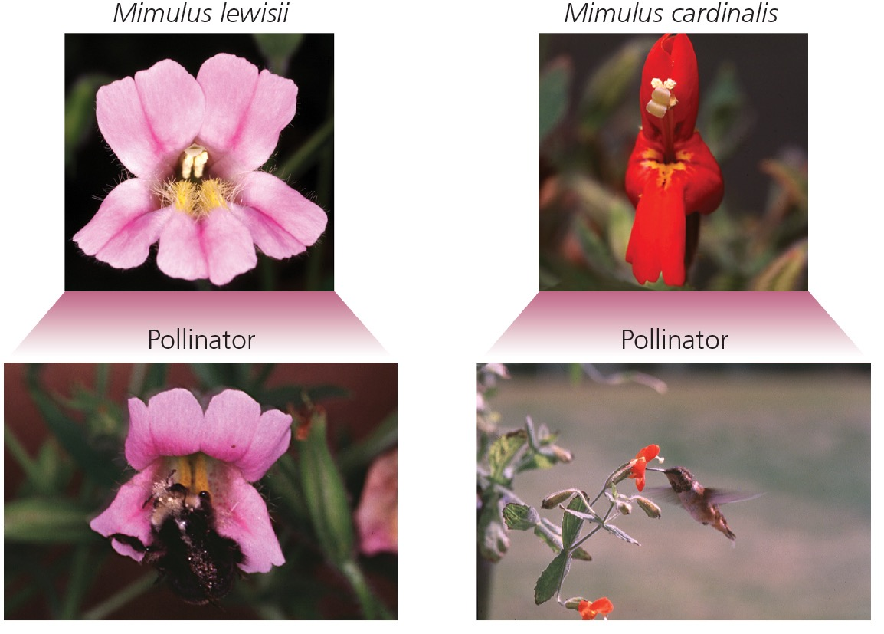
Mechanisms of reproductive isolation
Pre-mating isolation
Ecological isolation
Habitat isolation
Temporal isolation
Pollinator isolation
Behavioral isolation
Mechanical isolation

Slide 11
Mechanisms of reproductive isolation
Pre-mating isolation
Ecological isolation
Habitat isolation
Temporal isolation
Pollinator isolation
Behavioral isolation
Mechanical isolation

Slide 12
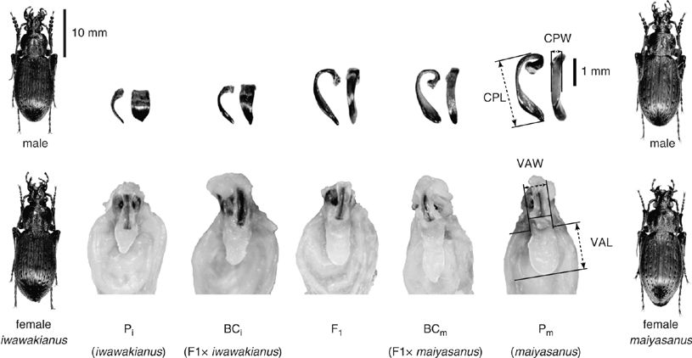
Mechanisms of reproductive isolation
Pre-mating isolation
Ecological isolation
Habitat isolation
Temporal isolation
Pollinator isolation
Behavioral isolation
Mechanical isolation

Slide 13
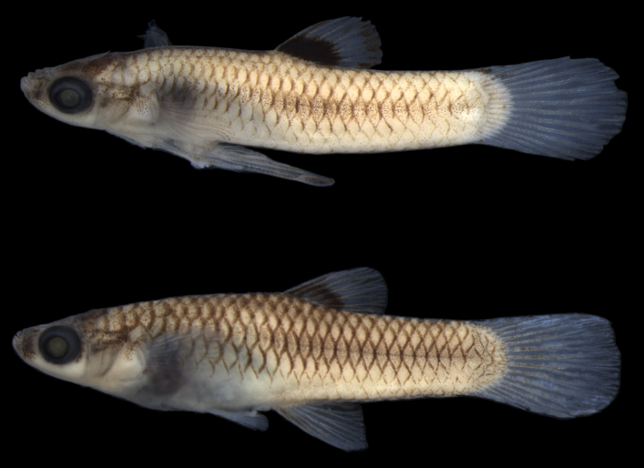
Mechanisms of reproductive isolation
Post-mating, pre-zygotic isolation
Copulatory behavioral isolation
Gametic isolation

Slide 14
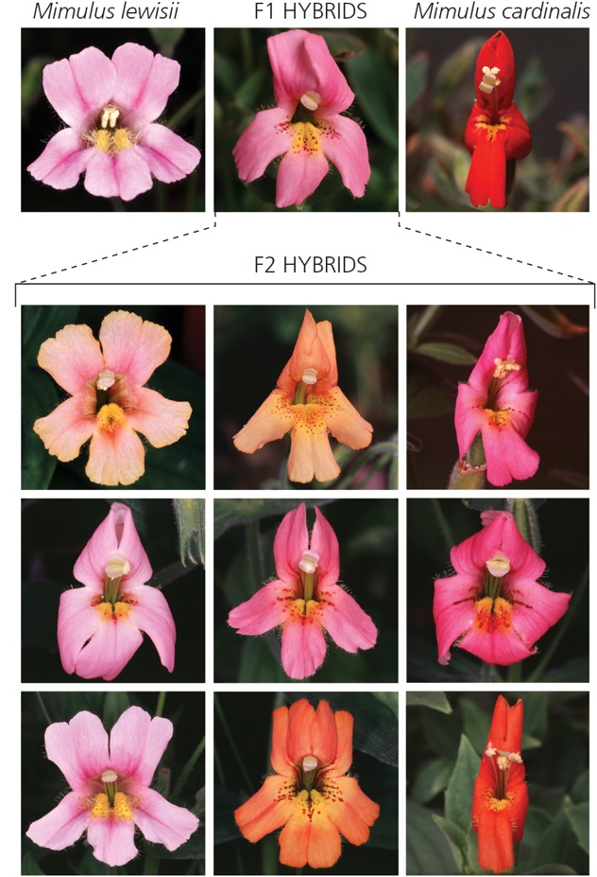
Mechanisms of reproductive isolation
Post-zygotic isolation
Intrinsic
Hybrid inviability
Hybrid sterility
Extrinsic
Ecological inviability
Behavioral sterility

Slide 15
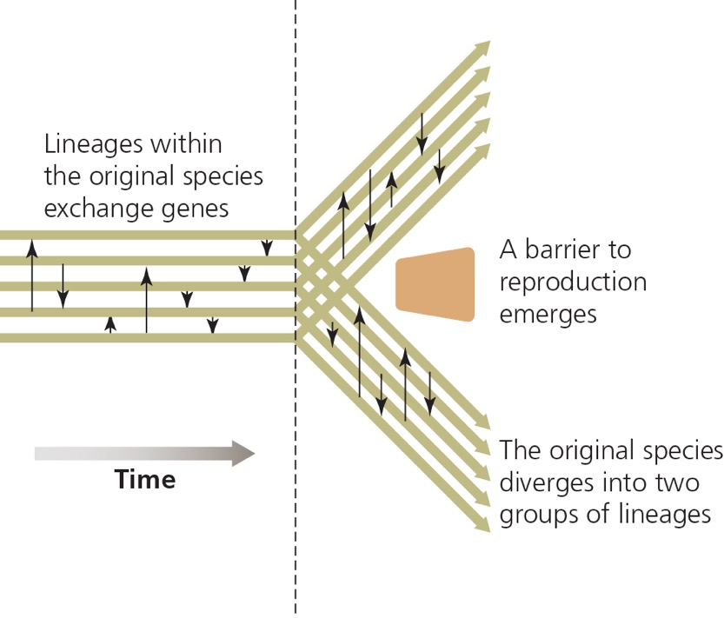
How do reproductive barriers evolve?
To understand the process of speciation, we need to understand how different evolutionary forces may impact barriers that cause reproductive isolation

Slide 16
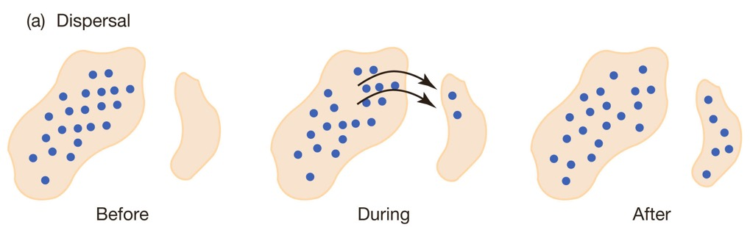
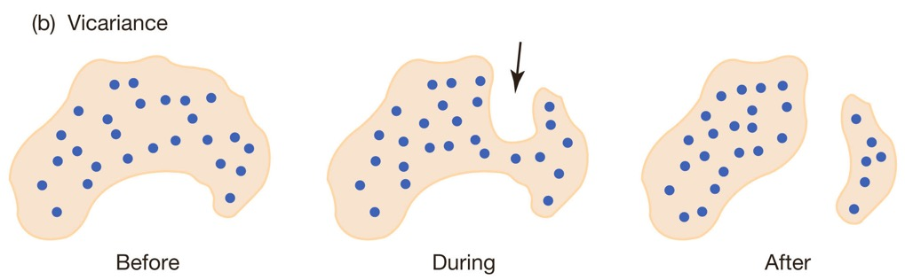
Allopatric speciation
Speciation initiated by geographic separation
Dispersal
Vicariance

Slide 17
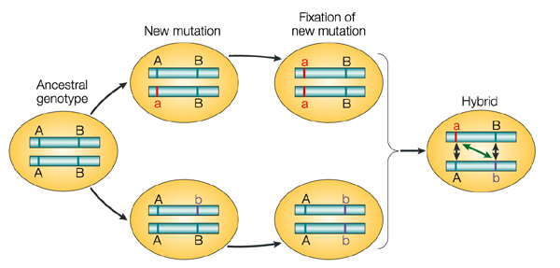
Allopatric speciation
What happens in isolation?
Divergence and speciation can occur in absence of selection (Dobzhansky-Muller incompatibilities)
Divergence in response to selection

Slide 18
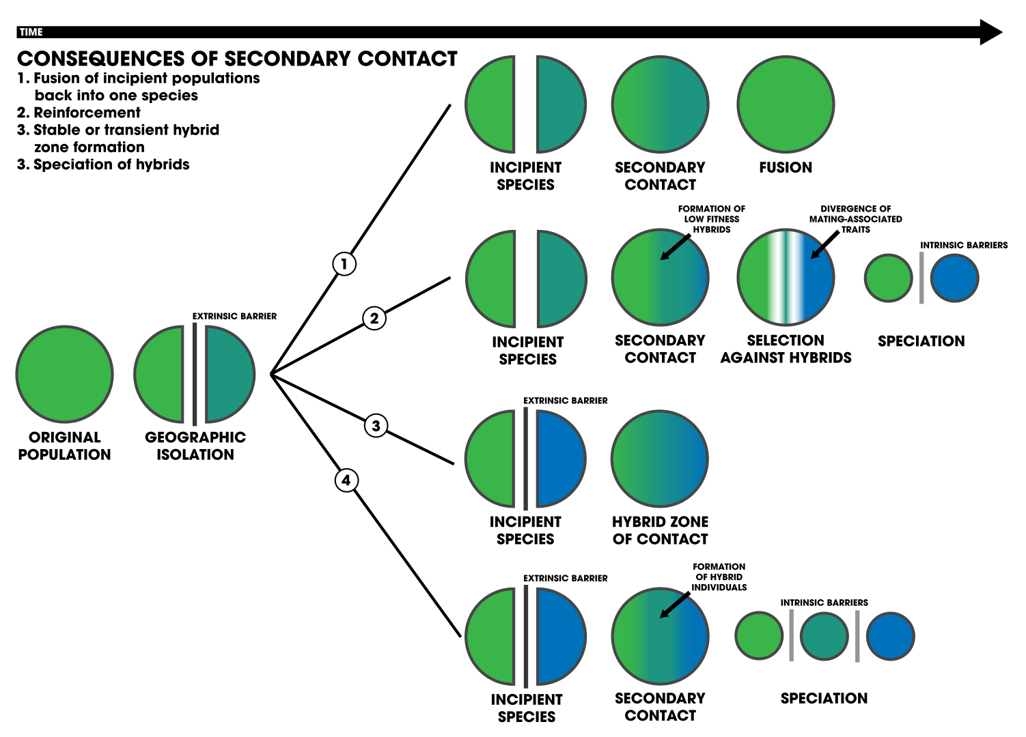
Allopatric speciation
What happens upon secondary contact?
Fusion (incipient speciation reversal)
Reinforcement
Hybrid zone or hybrid speciation

Slide 19
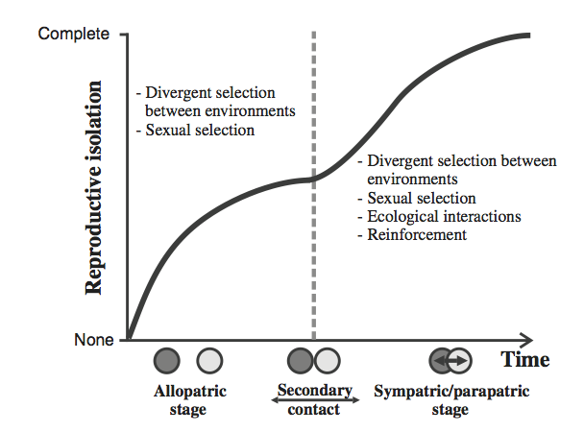
Reinforcement upon secondary contact
Reinforcement
Requires reduced hybrid fitness
Natural selection on pre-zygotic mechanisms of reproductive isolation complete the speciation process
Isolation > Divergence > Secondary contact

Slide 20
R Notebook, part 2
What is the role of reinforcement in speciation? Comparing premating isolation in sympatric and allopatric species of Drosophila
ggplot with geom_point and geom_smooth

Slide 21
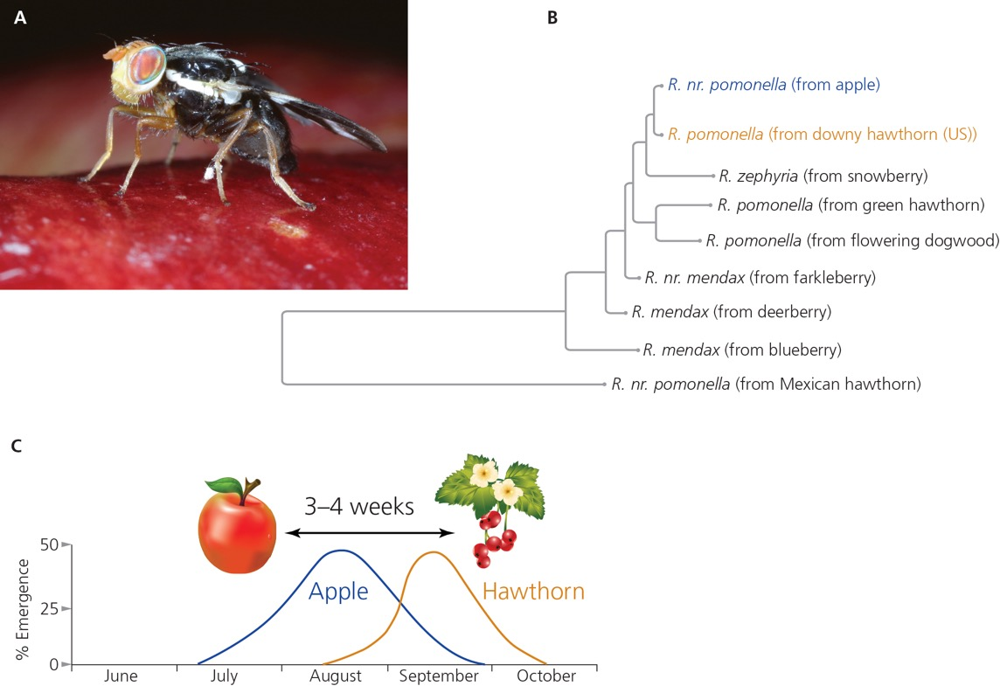
Non-allopatric speciation
New species appear to arise without physical separation
Speciation with gene flow (ecological speciation)
Divergent selection needs to be strong enough to overcome the homogenizing effects of gene flow
Adaptation causes speciation

Slide 22
Reproductive isolation as a byproduct of adaptation
Adaptive changes may inadvertently impact reproductive isolation as a byproduct
Potential partners…
… don’t meet
… don’t recognize each other
… are not compatible during mating
… produce unfit offspring

Slide 23
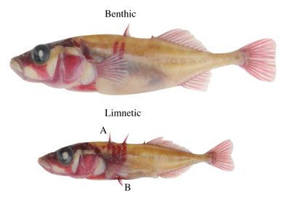
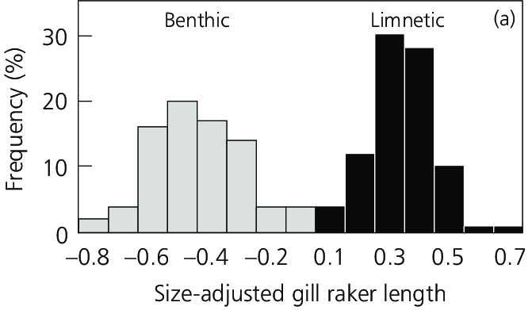
Ecological speciation in stickleback
Stickleback evolution upon freshwater colonization
Reduction is body armor and spines
Driven my reduction in predation and increases in costs
Evolved many times independently (in convergence)
Within freshwater lakes, there is sympatric divergence between benthic and limnetic stickleback
Changes in body size, shape, and coloration
Changes in trophic morphology

Slide 24
Ecological speciation in stickleback
Stickleback evolution upon freshwater colonization
Reduction is body armor and spines
Driven my reduction in predation and increases in costs
Evolved many times independently (in convergence)
Within freshwater lakes, there is sympatric divergence between benthic and limnetic stickleback
Changes in body size, shape, and coloration
Changes in trophic morphology

Slide 25
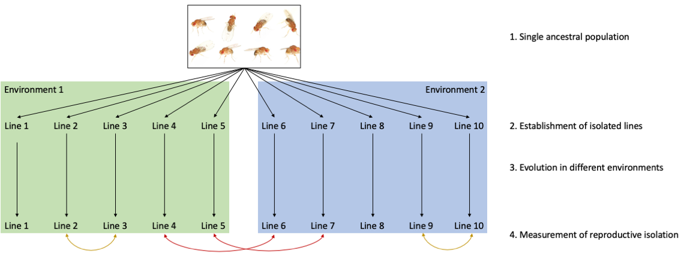
R Notebook, part 3
Adaptation and speciation 1: Does evolution in different environments cause speciation? Experimental evolution in Drosophila
ggplot with geom_boxplot

Slide 26
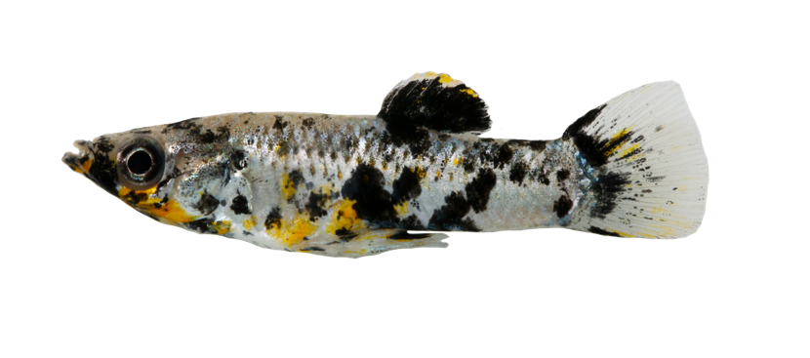
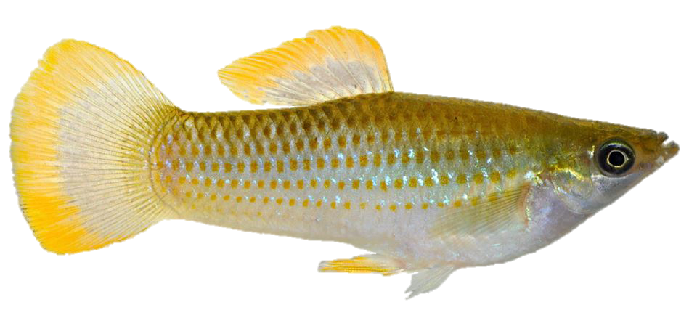
R Notebook, part 4
Adaptation and speciation 2: Does evolution in different environments cause speciation? (box plot, bar graphs)
ggplot with geom_boxplot
ggplot with geom_bar
ggplot with geom_bar or geom_point

Slide 27
How to read a structure plot?
Structure plots are a common output of population genetic analyses
They visualize the assignment probability of individuals to n populations based on their genetic makeup
Assignment probabilities provide insights into the degree of differentiation between populations
Assignment to population 1
Assignment to population 2
No differentiation
Complete differentiation
Partial differentiation
1.0
1.0
1.0
Probability
Probability
Probability
0.5
0.5
0.5
0.0
0.0
0.0
Individuals collected in population 1
Individuals collected in population 2
Individuals collected in population 1
Individuals collected in population 2
Individuals collected in population 1
Individuals collected in population 2

Slide 28
